Slide 1

DATABASE MANAGEMENT SYSTEMS | PBL
Employee Attendance, Shift and Leave Management System
Project 38: Design and Implementation of a Database Management System
Joshitha Chintakrinda | 25WU0102109
B.Tech (AI and ML), School of Technology, Woxsen University
Faculty: Dr. C. Nagaraju | Academic Year 2026 – 27

Slide 2
Problem and Objectives
The Problem
Objectives
Shift-based organisations consolidate rosters, punches, overtime and leave by hand. This causes double-booked staff, invalid punch times, unapproved overtime, leave beyond balance and payroll disputes.
Design the ER model and relational schema
Normalise to Third Normal Form
Enforce business rules with constraints and triggers
Build a Python application on the database
Validate with positive and negative tests
Joshitha Chintakrinda | 25WU0102109 | DBMS PBL
2

Slide 3
Scope and Proposed Solution
In Scope
Roles
Workflow
Employees and departments, shifts and rosters, clock-in/out, daily summary, overtime, leave types, balances and approvals, holidays, reports.
Employee: punch, apply leave, request overtime.
Manager: roster, approvals.
Admin / HR: master data and reports.
Roster → clock in/out → work-hour calculation → overtime / leave request → approval → balance update → reports.
Joshitha Chintakrinda | 25WU0102109 | DBMS PBL
3

Slide 4
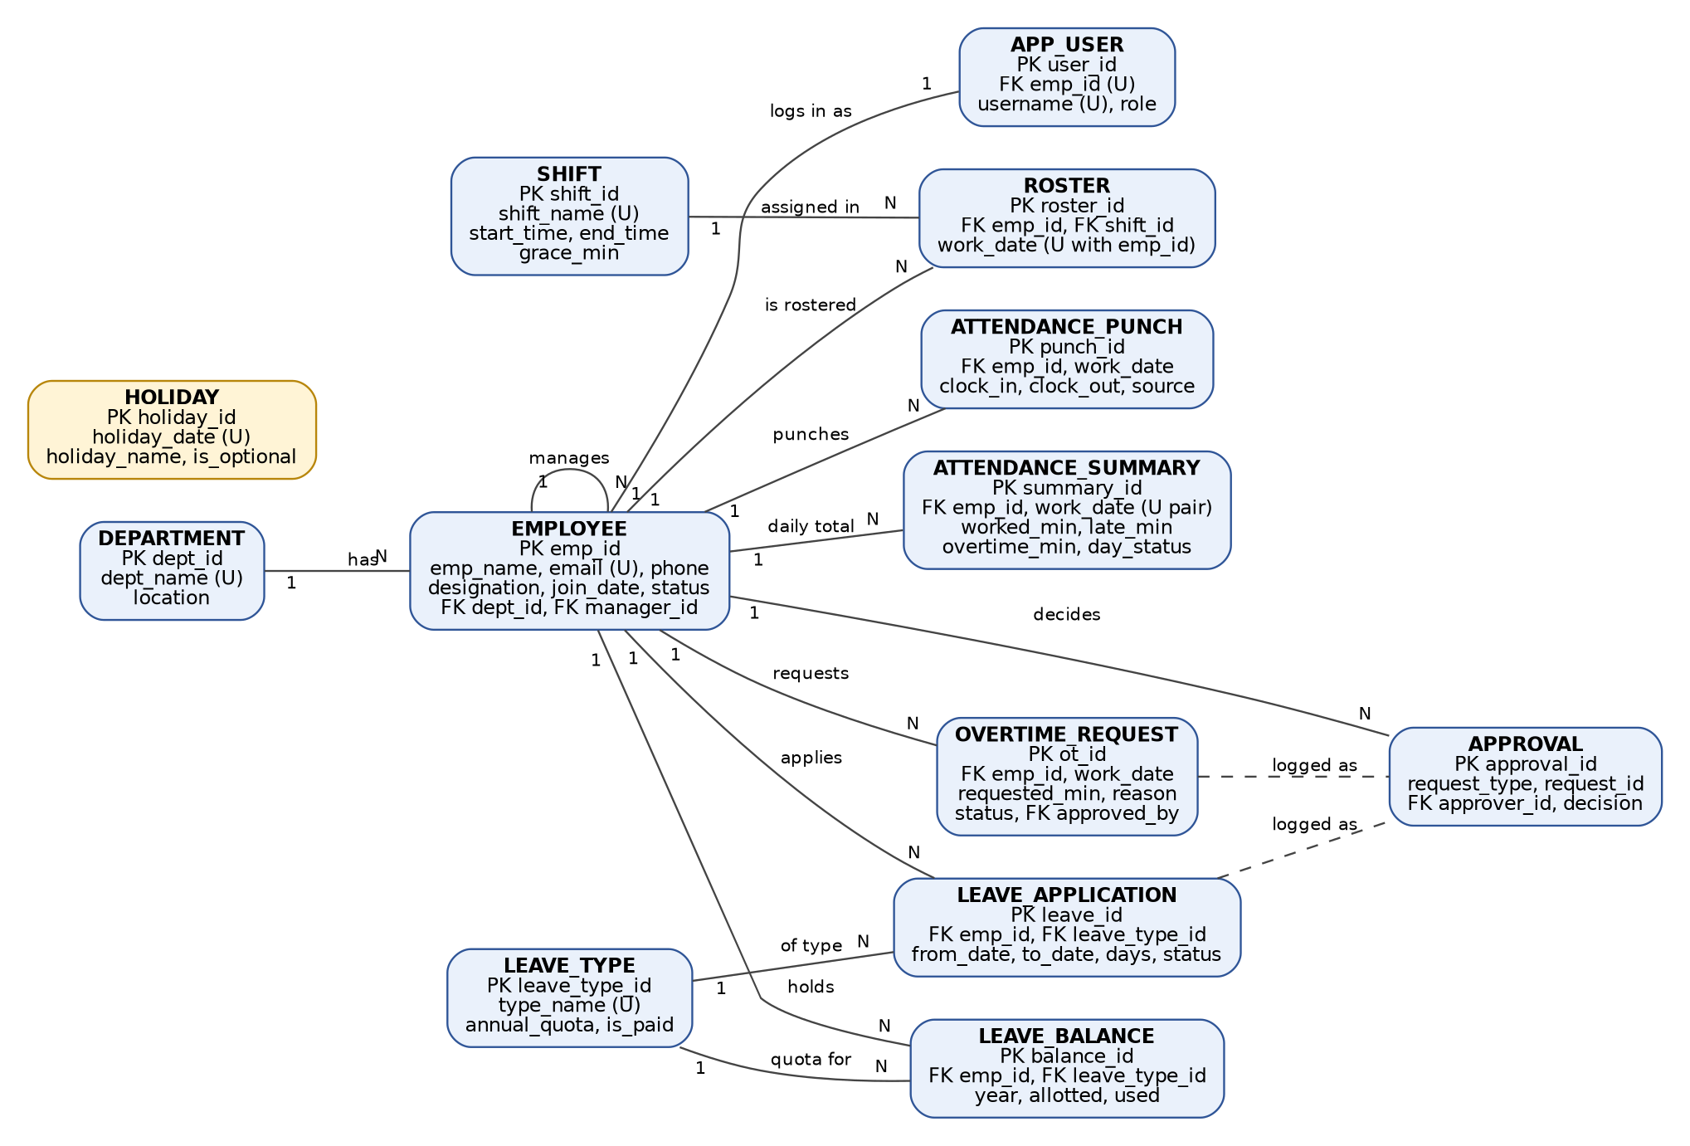
Entity-Relationship Diagram
13 entities | 1:N relationships from employee, shift and leave type | PK, FK and unique attributes marked
Joshitha Chintakrinda | 25WU0102109 | DBMS PBL
4

Slide 5
Logical Design and Normalization
13
2
4
3NF
tables
views
triggers
all relations (also BCNF)
Every entity became a relation; 1:N links are foreign keys on the many side
Department and shift details separated to remove transitive dependencies
Composite keys: (emp_id, work_date) for summary, (emp_id, leave_type_id, year) for balance
Remaining leave is derived in a view, not stored
Constraints used: PK, FK, UNIQUE, NOT NULL, CHECK, DEFAULT
Joshitha Chintakrinda | 25WU0102109 | DBMS PBL
5

Slide 6
Business Rules Enforced in the Database
No overlapping shifts
Unique index + roster trigger
Clock-out after clock-in
CHECK + update trigger
Leave within balance
Trigger on leave application
Authorised overtime only
Trigger on daily summary
One summary per employee per day
UNIQUE (emp_id, work_date)
Joshitha Chintakrinda | 25WU0102109 | DBMS PBL
6

Slide 7
Application Development
Technology
Transactions
Python 3.12 with the sqlite3 module, SQLite 3.45.1, console menu. All SQL uses parameterised queries.
Leave approval updates status, approval log and balance in one transaction with rollback on error.
Modules
Employee maintenance (CRUD) | Roster preparation | Clock-in / clock-out | Work-hour calculation (worked, late, approved overtime) | Overtime approval | Leave processing | Reports
Joshitha Chintakrinda | 25WU0102109 | DBMS PBL
7

Slide 8
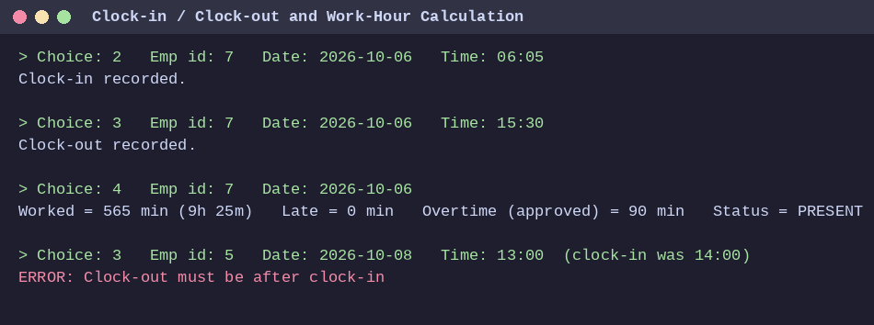
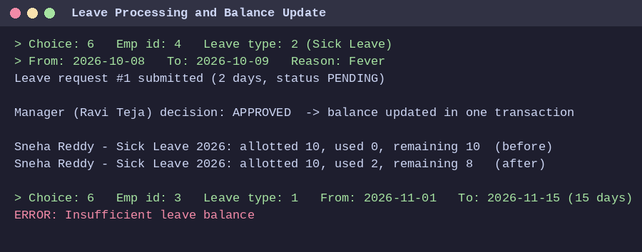
Application Screens
Clock-in, clock-out and work-hour calculation: worked time, lateness and approved overtime
Leave approval updates the balance in one transaction
Rejected inputs show clear database messages
Joshitha Chintakrinda | 25WU0102109 | DBMS PBL
8

Slide 9
Reports and Testing
14 / 14
Reports (SQL concepts)
Weekly roster: JOIN
Lateness: view + WHERE
Absence: NOT EXISTS subquery
Overtime: GROUP BY + SUM
Leave balance: view
Shift coverage: GROUP BY + HAVING
Department summary: aggregates
Above-average workers: nested query
test cases passed, including negative cases: overlapping shift, clock-out before clock-in, excess leave, unauthorised overtime, duplicate summary, foreign key and unique violations, rollback
Joshitha Chintakrinda | 25WU0102109 | DBMS PBL
9

Slide 10
Conclusion and Future Work
Conclusion
Future enhancements
A 13-entity ER model became a 3NF schema with rules enforced inside the database. The Python application and 14 passing tests show reliable attendance, overtime and leave handling.
Port to MySQL or PostgreSQL
Web or desktop front end
Login with password hashing
Biometric integration and payroll export
Automatic roster suggestions
Thank you
Joshitha Chintakrinda | 25WU0102109 | DBMS PBL
10

